Slide 1


Slide 2
Introduction to Networking
In Java
Sockets, HTTP and HTML Parsing

Slide 3
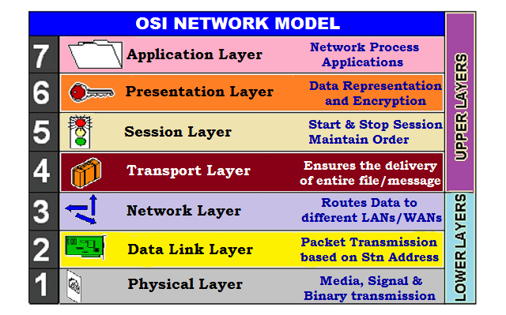
Networking
The core infrastructure that makes cloud computing possible is “the network”
Networking is an extremely complex topic
At right is the OSI Network Model, a common framework for understanding how networking works
Notes:
Can be found online… but I can’t link to it

Slide 4
Networking
Since this is an overview, we won’t be going into the lower level details
However, before we move into the code, I want to mention two technologies:
IP
TCP
Notes:
Can be found online… but I can’t link to it

Slide 5
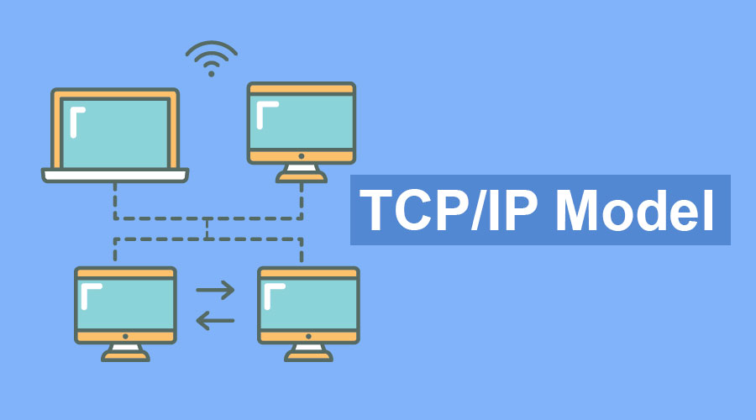
Networking
IP: The Internet Protocol
A low level protocol for identifying hosts (computers) on the network and sending information to them, or receiving information from them
Notes:
Can be found online… but I can’t link to it

Slide 6
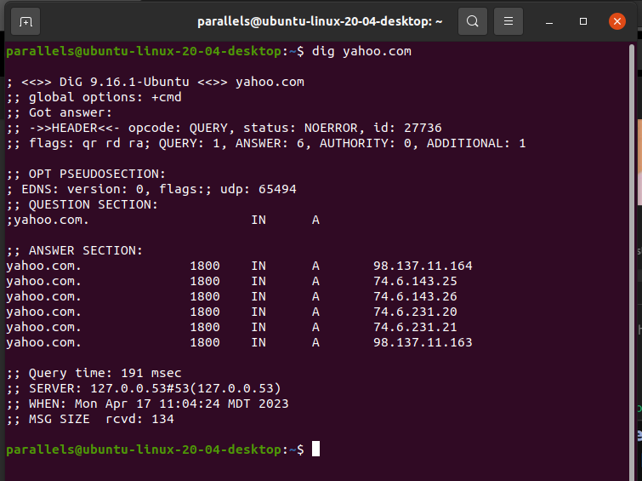
Networking
IP is where the term “ip address” comes from
dig is a command line tool available on linux, allowing you to turn a Domain Name into an IP address
This is done via DNS
The Domain Naming System
Notes:
Can be found online… but I can’t link to it

Slide 7
Networking
DNS is a distributed protocol for turning Domain Names into IP addresses
You may be familiar with URLs: Universal Resource Locators
URLs include a Domain Name
Notes:
Can be found online… but I can’t link to it

Slide 8
Networking
Here you can see that the domain name “yahoo.com” resolves to the IP address 98.137.11.164, etc.
“Yahoo” is a vintage website that was very popular a few decades ago!
If you go to “yahoo.com” in a browser, the browser will actually connect to one of these IP addresses
Notes:
Can be found online… but I can’t link to it

Slide 9
Networking
TCP: Transmission Control Protocol
TCP is protocol built on top of IP to reliably communicate information with a remote computer
IP has no notion of confirmation that a remote system has received a piece of information
Notes:
Can be found online… but I can’t link to it

Slide 10
Networking
TCP: Transmission Control Protocol
There is actually another protocol built on top of IP that doesn’t make those guarantees: UDP
UDP is a fire-and-forget protocol used for streaming/gaming, etc.
Much faster, much lower latency
Notes:
Can be found online… but I can’t link to it

Slide 11
Networking
TCP and IP technologies are so frequently used together that they are often referred to as TCP/IP
TCP/IP is the most common protocol on the internet today, even in many places where it isn’t the ideal choice!
Worse is better!
Notes:
Can be found online… but I can’t link to it

Slide 12
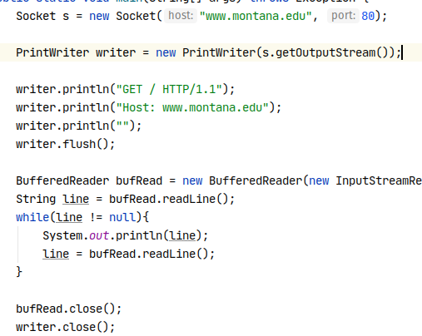
Writing Network Code
The primary abstraction that programmers use when writing networking code is known as a socket
Java has a pretty nice object oriented networking library found in the java.net package
Notes:
Can be found online… but I can’t link to it

Slide 13
Writing Network Code
Sockets come in two flavors:
Client Sockets
Server Sockets
Client Sockets are sockets that connect to another computer
Server Sockets are sockets that listen for a connection to the current computer
Notes:
Can be found online… but I can’t link to it

Slide 14
Writing Network Code
At right is some client socket code
We create an instance of a Socket class, giving it a server name and a port to connect to
Server name: resolved via DNS to an IP address for us
Port: A numeric value
Notes:
Can be found online… but I can’t link to it

Slide 15
Writing Network Code
Ports
Ports are a way for multiple programs to share the networking infrastructure of a computer without conflicting with one another
Many protocols have well known “default” ports:
Http: port 80
Ssh: port 22
Notes:
Can be found online… but I can’t link to it

Slide 16
Writing Network Code
Ports
There is no law that a given program has to be running on a given port
Some operating systems restrict running on lower numbered ports to root or admin user-started processes only
Higher numbered ports are generally widely available and can be a little chaotic
Notes:
Can be found online… but I can’t link to it

Slide 17
Writing Network Code
OK, so back to the code at right
We create a socket pointing to a given machine and port
We then create a PrintWriter that wraps the OutputStream of the socket
This will allow us to send data to the remote server
Notes:
Can be found online… but I can’t link to it

Slide 18
Writing Network Code
Question:
Why a PrintWriter?
Why not use the OutputStream directly?
OutputStream is low level, works in terms of bytes
PrintWriter allows us to work in higher-level terms
This is an example of the Decorator Pattern
Notes:
Can be found online… but I can’t link to it

Slide 19
Writing Network Code
Using the print writer, we send some lines of text to the remote system
Here we are sending code conforming to the HTTP protocol, asking for the root document
Notes:
Can be found online… but I can’t link to it

Slide 20
Writing Network Code
After we send data up to the server on the socket, ensuring it is all sent with a flush() call, we can listen for the response on the same socket
Again we use the decorator pattern to get a BufferedReader
Notes:
Can be found online… but I can’t link to it

Slide 21
Writing Network Code
The BufferedReader will return lines of text or, if no lines are available, null
We can read the response and print it out to the console
Let’s take a look at the response! DEMO
Notes:
Can be found online… but I can’t link to it

Slide 22
Writing Network Code
Note at the end of the program, we close the writers and sockets
Necessary to free up OS-level resources associated with the socket
Turns out there can be resource leaks in java!
Notes:
Can be found online… but I can’t link to it

Slide 23
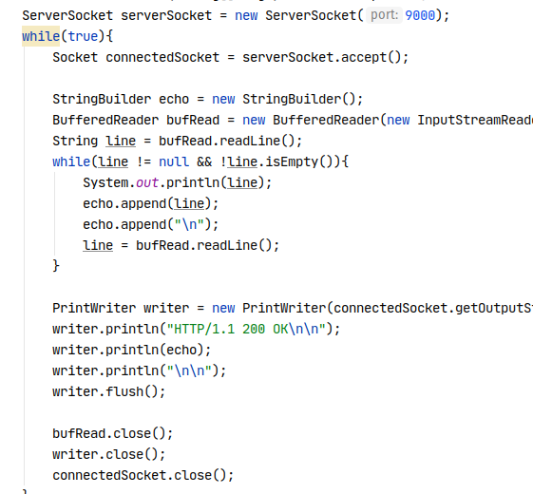
Writing Network Code
OK, so that’s the client side of things
But we were talking to a server, listening on port 80 at montana.edu
What does the server side of things look like?
Notes:
Can be found online… but I can’t link to it

Slide 24
Writing Network Code
It’s a little bit more code, but sure looks familiar doesn’t it?
We have a new class, ServerSocket
The constructor takes a port to listen on
All that’s really new here is the accept() method
This is where we accept new connections when a client connects to the server
Notes:
Can be found online… but I can’t link to it

Slide 25
Writing Network Code
Once a client has connected, we are given back a… normal socket to communicate with them through
Since we are on the server, we reverse the reading and writing:
First we read in the clients request
Then we respond, echoing it back to them
Notes:
Can be found online… but I can’t link to it

Slide 26
Writing Network Code
Not too bad, is it?
So what is all that gobbledygook stuff around “HTTP/1.0 blah blah blah”
We have been implementing very simple, very broken HTTP clients
Next time we’ll take a look at HTTP, HTML and Hypermedia!
Notes:
Can be found online… but I can’t link to it

Slide 27
Sockets, HTTP and HTML Parsing
OK, so what did we look at today?
We took a brief look at the networking layer model, including TCP/IP
Sockets, both client and server versions
Client sockets connect to a remote server
Server sockets listen for connections

